Slide 1

pyAllHillShadedWaterfall
Development Notes, August 2016

Slide 2

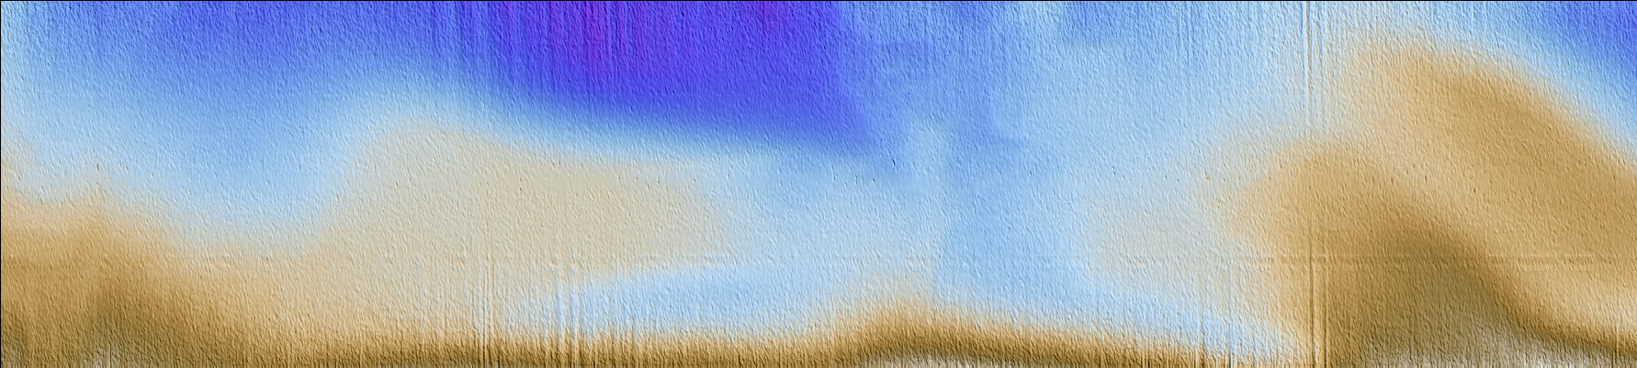
EM710 Sample: 0003_20110822_092831_Vector.all
Conventional processed file with lastools hillshading
Python waterfall hillshading with jeca depth palette
Confirm the –r (rotate) option runs left to right
Auto stretch in across track axis to approximate real world pixel isometry

Slide 3
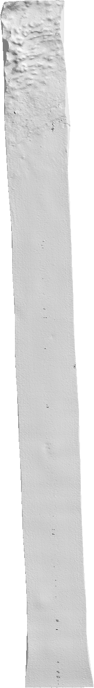
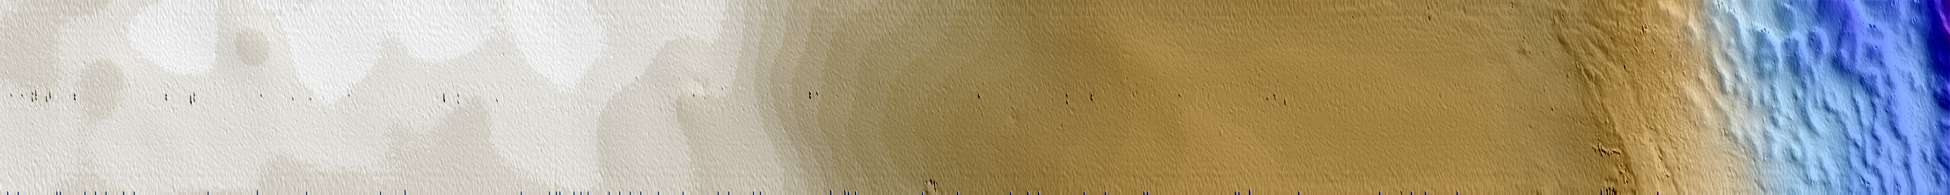
em2000-0005-vsm3_15-20151123-023334.all

Slide 4
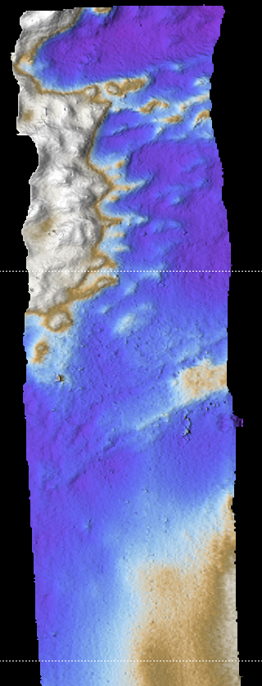
em2000-0005-vsm3_15-20151123-023334.all

Slide 5



C:/development/python/0004_20110307_041009.all
Jeca 64 Colors. Note contouring at color boundaries Bad!
Jeca 256 Colors

Slide 6
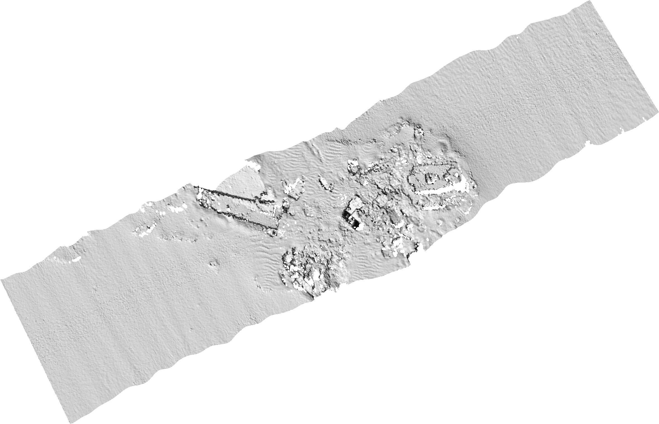
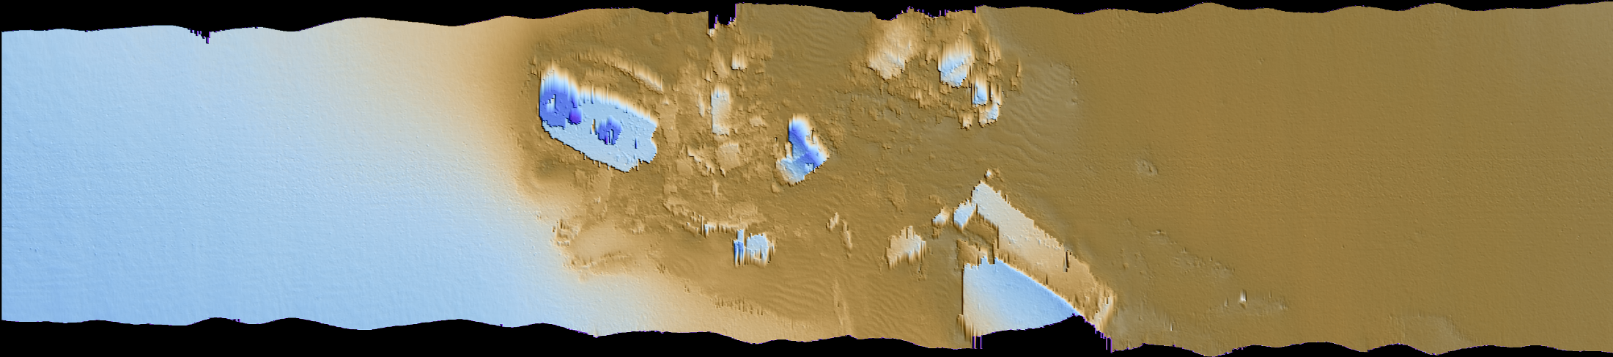
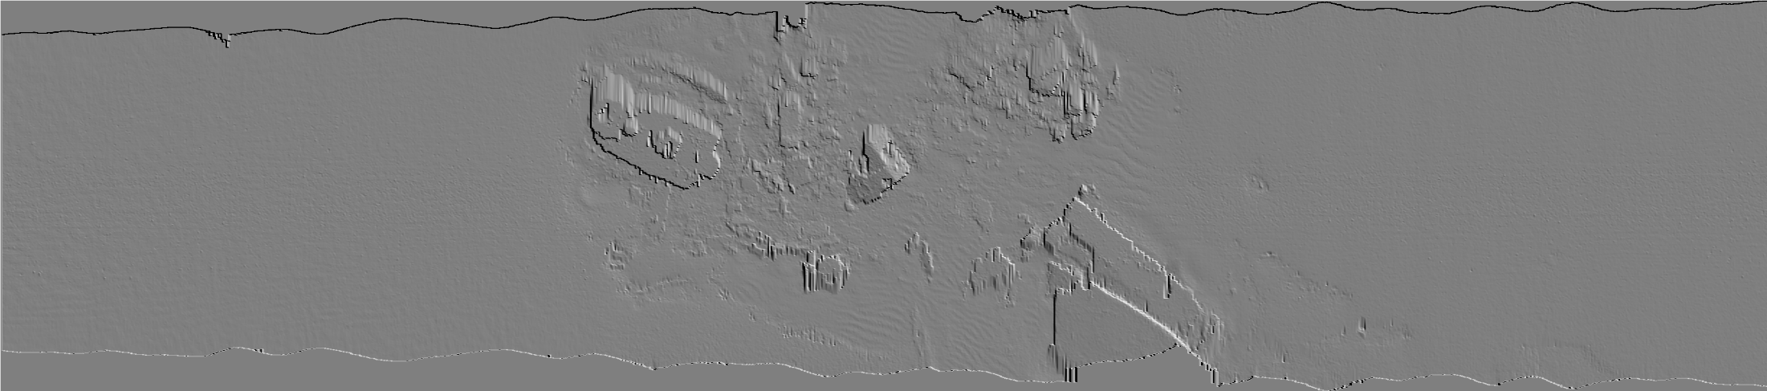
Jeca 64 Colors. Note contouring at color boundaries Bad!
Jeca 256 Colors

